Slide 1



BRISBANE | 24-25 NOVEMBER 2025

Slide 2





More than accuracy:
How artificial intelligence outputs are presented to clinicians, matters
Speaker Monica Noselli
PhD Candidate at The University of Queensland
Queensland Digital Healthcare Centre
UQ-QH-HDR Alliance Program
ENGAGE. DISRUPT. TRANSFORM.

Slide 3







AI in Healthcare: model development and evaluation
Accuracy
ENGAGE. DISRUPT. TRANSFORM.

Slide 4





AI in Healthcare: Different Mindset
Computer Scientists
Clinicians
Data-centered
Exploration, discover new insight
Model
Patient-centered
Exploitation, Confirm old knowledge
Clinical Plausibility (clinical context)
ENGAGE. DISRUPT. TRANSFORM.
Bienefeld, N., Boss, J.M., Lüthy, R. et al. Solving the explainable AI conundrum by bridging clinicians’ needs and developers’ goals. npj Digit. Med. 6, 94 (2023). https://doi.org/10.1038/s41746-023-00837-4

Slide 5
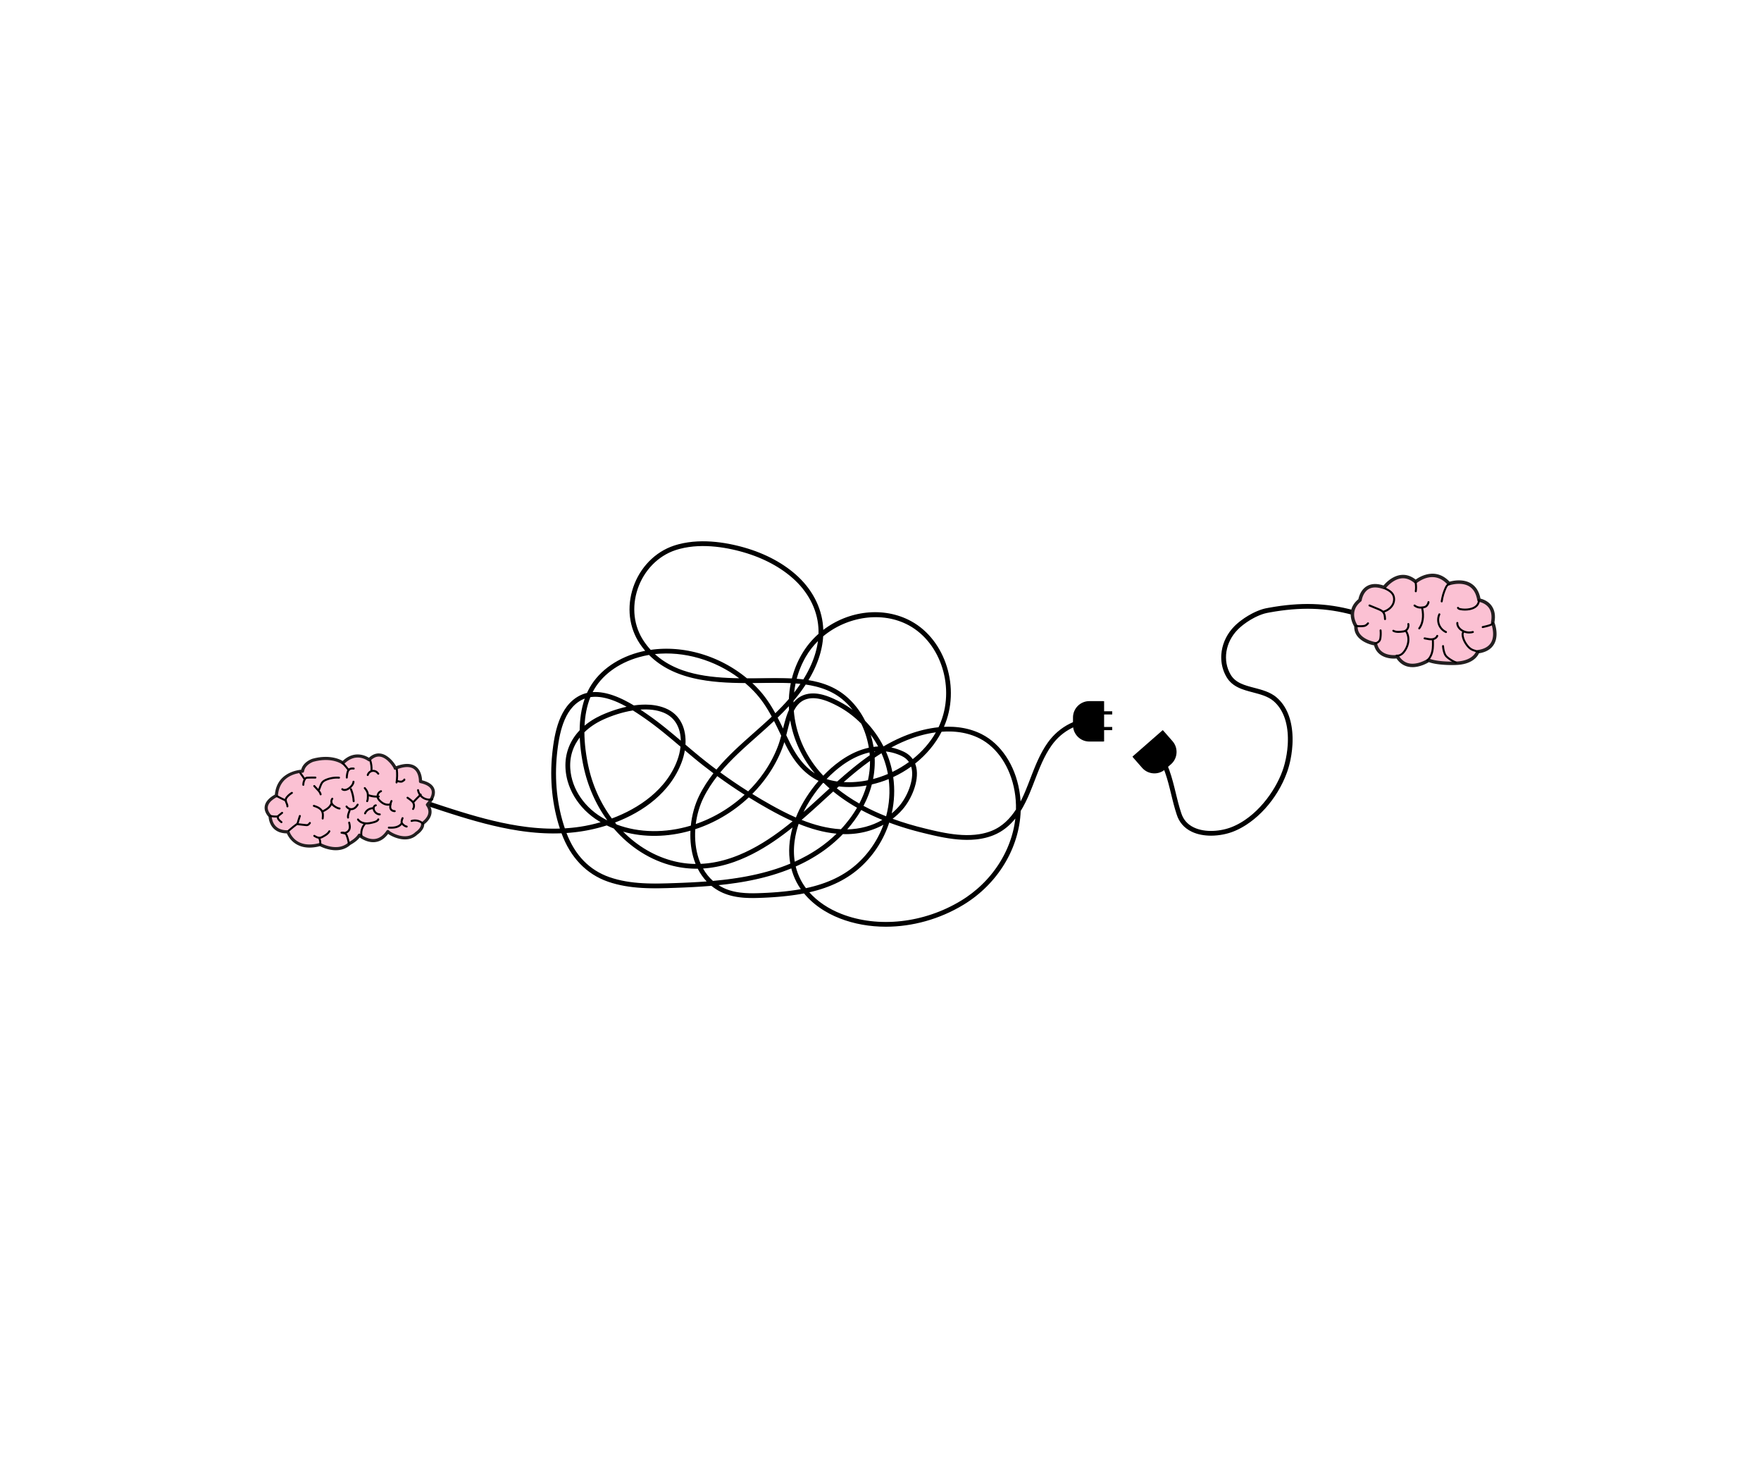


AI in Healthcare: User interface (UI) - User Experience (UX)
to link algorithm performance and clinical impact
ENGAGE. DISRUPT. TRANSFORM.
Bienefeld, N., Boss, J.M., Lüthy, R. et al. Solving the explainable AI conundrum by bridging clinicians’ needs and developers’ goals. npj Digit. Med. 6, 94 (2023). https://doi.org/10.1038/s41746-023-00837-4

Slide 6
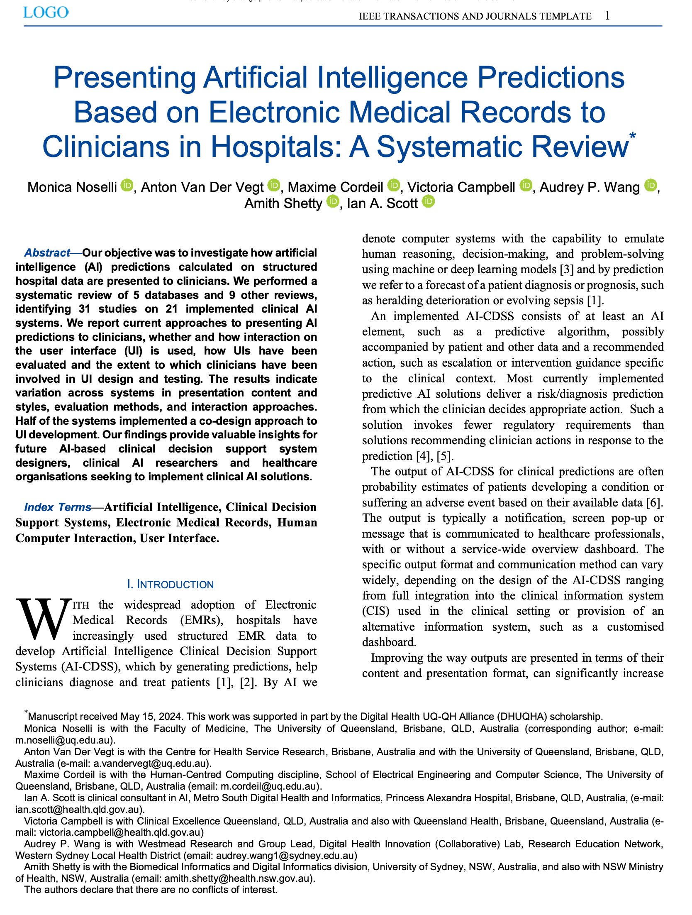

Systematic literature review
RQ-1 - How are clinicians involved in Artificial Intelligence Clinical Decision Support (AI-CDSS) design?
RQ-2 - How are AI prediction presentation methods (UI) evaluated?
RQ-3 - How are AI predictions presented to clinicians?
RQ-4 - When are interactive, rather than static, visualisations used and what is their purpose and value?

Slide 7
Systematic literature review
trialed or implemented in hospital settings employing AI models and
EMR based (no imaging)
21 Systems

Slide 8
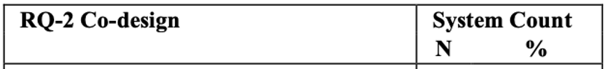
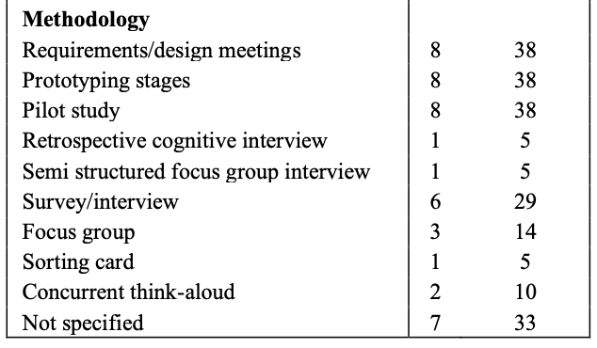
RQ-1 - How are clinicians involved in Artificial Intelligence Clinical Decision Support (AI-CDSS) design?
Systems | xAI | interact | co-design | UI evaluated
CarePre | yes | yes | yes | yes
Trews | yes | yes | yes | yes
E | yes | yes | yes | yes
G | yes | yes | yes | yes
Q | yes | yes | yes | yes
N | yes | yes | yes | yes
RetainVis | yes | yes | yes | no
F | yes | no | yes | yes
D | yes | no | yes | yes
I | yes | no | yes | no
B | yes | no | unclear | yes
C | yes | no | unclear | yes
H | yes | no | unclear | yes
L | yes | no | unclear | no
Sepsis Watch | no | yes | yes | yes
O | no | yes | unclear | no
M | no | yes | unclear | no
K | no | no | unclear | no
AUTO | no | no | unclear | no
P | no | no | unclear | no
Previse | no | no | unclear | no
~50% (n=11) Co-designed
ENGAGE. DISRUPT. TRANSFORM.

Slide 9
RQ-1 - How are clinicians involved in Artificial Intelligence Clinical Decision Support (AI-CDSS) design?
Systems | xAI | interact | co-design | UI evaluated
CarePre | yes | yes | yes | yes
Trews | yes | yes | yes | yes
E | yes | yes | yes | yes
G | yes | yes | yes | yes
Q | yes | yes | yes | yes
N | yes | yes | yes | yes
RetainVis | yes | yes | yes | no
F | yes | no | yes | yes
D | yes | no | yes | yes
I | yes | no | yes | no
B | yes | no | unclear | yes
C | yes | no | unclear | yes
H | yes | no | unclear | yes
L | yes | no | unclear | no
Sepsis Watch | no | yes | yes | yes
O | no | yes | unclear | no
M | no | yes | unclear | no
K | no | no | unclear | no
AUTO | no | no | unclear | no
P | no | no | unclear | no
Previse | no | no | unclear | no
Codesigned systems implemented
explainability techniques (xAI)
interactions
only 3 (dark blue) High Quality User Interface Evaluation
ENGAGE. DISRUPT. TRANSFORM.
ENGAGE. DISRUPT. TRANSFORM.

Slide 10
RQ-2 - How are AI prediction presentation methods (UI) evaluated?
Systems | xAI | interact | co-design | UI evaluated | other evaluation
CarePre | yes | yes | yes | yes | yes
Trews | yes | yes | yes | yes | yes
E | yes | yes | yes | yes | yes
G | yes | yes | yes | yes | yes
Q | yes | yes | yes | yes | yes
N | yes | yes | yes | yes | no
RetainVis | yes | yes | yes | no | yes
F | yes | no | yes | yes | yes
D | yes | no | yes | yes | no
I | yes | no | yes | no | yes
B | yes | no | unclear | yes | no
C | yes | no | unclear | yes | no
H | yes | no | unclear | yes | no
L | yes | no | unclear | no | yes
Sepsis Watch | no | yes | yes | yes | yes
O | no | yes | unclear | no | yes
M | no | yes | unclear | no | yes
K | no | no | unclear | no | yes
AUTO | no | no | unclear | no | yes
P | no | no | unclear | no | yes
Previse | no | no | unclear | no | yes
>50% (n=12) were user interface evaluated
QL n=6
Systems that were High Quality User Interface Evaluated (6/21)
Mixed Methods Appraisal Tool*
a critical appraisal tool for evaluating the quality of qualitative, quantitative, and mixed-methods studies
ENGAGE. DISRUPT. TRANSFORM.
* Q. N. Hong et al., “The Mixed Methods Appraisal Tool (MMAT) version 2018 for information professionals and researchers,” Educ. Inf., vol. 34, no. 4, pp. 285–291, 2018, doi: 10.3233/EFI-180221.

Slide 11
RQ-2 - How are AI prediction presentation methods (UI) evaluated?
Systems | xAI | interact | co-design | UI evaluated | other evaluation
CarePre | yes | yes | yes | yes | yes
Trews | yes | yes | yes | yes | yes
E | yes | yes | yes | yes | yes
G | yes | yes | yes | yes | yes
Q | yes | yes | yes | yes | yes
N | yes | yes | yes | yes | no
RetainVis | yes | yes | yes | no | yes
F | yes | no | yes | yes | yes
D | yes | no | yes | yes | no
I | yes | no | yes | no | yes
B | yes | no | unclear | yes | no
C | yes | no | unclear | yes | no
H | yes | no | unclear | yes | no
L | yes | no | unclear | no | yes
Sepsis Watch | no | yes | yes | yes | yes
O | no | yes | unclear | no | yes
M | no | yes | unclear | no | yes
K | no | no | unclear | no | yes
AUTO | no | no | unclear | no | yes
P | no | no | unclear | no | yes
Previse | no | no | unclear | no | yes
>50% (n=12) were user interface evaluated
QL n=6
Systems that were High Quality User Interface Evaluated (6/21)
~75% (n=16)
outcome (e.g., mortality rate and ICU transfer)
algorithm performance evaluation (e.g., Accuracy)
ENGAGE. DISRUPT. TRANSFORM.

Slide 12
So what?
Leverage codesign wisely:
Codesign helps align the system with clinical workflow and user comprehension but may also introduce subjective preferences without objective validation.
Rigorous Evaluation:
Ensure thorough UI evaluations with clinicians are conducted and transparently reported before implementation.
ENGAGE. DISRUPT. TRANSFORM.

Slide 13
System Label | Care Setting | Structure
B | ICU | Distributed
C | ED | Distributed
D | unclear | Centralised
E | ED, W | unclear
F | unclear | Centralised
G | unclear | Distributed
H | W | Distributed
I | ED, W | Centralised
K | unclear | Centralised
L | W | Distributed
M | W | Distributed
N | ICU | Distributed
O | ICU, W | Centralised
 | ICU | Centralised
P | ED, W | Centralised
 | ED, W | unclear
Q | ICU | Distributed
 | ICU | Distributed
 | ED | Distributed
CarePre | unclear | unclear
Retainvis | unclear | unclear
Previse | ICU, ED | Centralised
 | ED, W | Centralised
AUTO | ICU, ED, W | Distributed
 | ICU | Distributed
SepsisWatch | ED | Centralised
 | ED | Centralised
 | ED | Centralised
Trews | ED, W | Distributed
 | ED, W | Distributed
 | ICU | Distributed
RQ-3 - How are AI predictions presented to clinicians?
Structure
Centralised: predictions are presented to a single dedicated recipient, such as a nurse monitoring multiple patient cohorts
Distributed: predictions are sent to multiple recipients, such as bedside nurses caring for a set number of patients or doctors who are in care of the patient.
ENGAGE. DISRUPT. TRANSFORM.

Slide 14



System Label | Care Setting | Structure
B | ICU | Distributed
C | ED | Distributed
D | unclear | Centralised
E | ED, W | unclear
F | unclear | Centralised
G | unclear | Distributed
H | W | Distributed
I | ED, W | Centralised
K | unclear | Centralised
L | W | Distributed
M | W | Distributed
N | ICU | Distributed
O | ICU, W | Centralised
 | ICU | Centralised
P | ED, W | Centralised
 | ED, W | unclear
Q | ICU | Distributed
 | ICU | Distributed
 | ED | Distributed
CarePre | unclear | unclear
Retainvis | unclear | unclear
Previse | ICU, ED | Centralised
 | ED, W | Centralised
AUTO | ICU, ED, W | Distributed
 | ICU | Distributed
SepsisWatch | ED | Centralised
 | ED | Centralised
 | ED | Centralised
Trews | ED, W | Distributed
 | ED, W | Distributed
 | ICU | Distributed
RQ-3 - How are AI predictions presented to clinicians?
Devices
Human resources
Infrastructure
Personalisation/Customisation
Structure
Centralised: predictions are presented to a single dedicated recipient, such as a nurse monitoring multiple patient cohorts
Distributed: predictions are sent to multiple recipients, such as bedside nurses caring for a set number of patients or doctors who are in care of the patient.
ENGAGE. DISRUPT. TRANSFORM.

Slide 15
System Label | Care Setting | Structure
B | ICU | Distributed
C | ED | Distributed
D | unclear | Centralised
E | ED, W | unclear
F | unclear | Centralised
G | unclear | Distributed
H | W | Distributed
I | ED, W | Centralised
K | unclear | Centralised
L | W | Distributed
M | W | Distributed
N | ICU | Distributed
O | ICU, W | Centralised
 | ICU | Centralised
P | ED, W | Centralised
 | ED, W | unclear
Q | ICU | Distributed
 | ICU | Distributed
 | ED | Distributed
CarePre | unclear | unclear
Retainvis | unclear | unclear
Previse | ICU, ED | Centralised
 | ED, W | Centralised
AUTO | ICU, ED, W | Distributed
 | ICU | Distributed
SepsisWatch | ED | Centralised
 | ED | Centralised
 | ED | Centralised
Trews | ED, W | Distributed
 | ED, W | Distributed
 | ICU | Distributed
RQ-3 - How are AI predictions presented to clinicians?
Care Setting
Intensive Care Unit - Emergency Department - Ward
Different
clinical workflow and decision timeline
amount, type, and quality of data collected
roles and team structures
alert tolerance and cognitive load
clinical priorities
infrastructure and integration constraints
ENGAGE. DISRUPT. TRANSFORM.

Slide 16

System Label | Care Setting | Structure
B | ICU | Distributed
C | ED | Distributed
D | unclear | Centralised
E | ED, W | unclear
F | unclear | Centralised
G | unclear | Distributed
H | W | Distributed
I | ED, W | Centralised
K | unclear | Centralised
L | W | Distributed
M | W | Distributed
N | ICU | Distributed
O | ICU, W | Centralised
 | ICU | Centralised
P | ED, W | Centralised
 | ED, W | unclear
Q | ICU | Distributed
 | ICU | Distributed
 | ED | Distributed
CarePre | unclear | unclear
Retainvis | unclear | unclear
Previse | ICU, ED | Centralised
 | ED, W | Centralised
AUTO | ICU, ED, W | Distributed
 | ICU | Distributed
SepsisWatch | ED | Centralised
 | ED | Centralised
 | ED | Centralised
Trews | ED, W | Distributed
 | ED, W | Distributed
 | ICU | Distributed
RQ-3 - How are AI predictions presented to clinicians?
Personalisation
Customisation
Communication
Care Setting
Intensive Care Unit - Emergency Department - Ward
Different
clinical workflow and decision timeline
amount, type, and quality of data collected
roles and team structures
alert tolerance and cognitive load
clinical priorities
infrastructure and integration constraints
ENGAGE. DISRUPT. TRANSFORM.

Slide 17
So what?
Support customisation and communication:
Allow UI tailoring to clinician needs: the UI is the critical to link algorithm performance and clinical impact.
ENGAGE. DISRUPT. TRANSFORM.

Slide 18
RQ-3 - How are AI predictions presented to clinicians?
RQ-1 Presentation | Systems Count
 | N | %
Integrated in EHR | 6 | 29
Stand-alone web-based (e.g., dashboard) | 11 | 52
Integrated & web-based | 4 | 19
Unclear | 1 | 5
ENGAGE. DISRUPT. TRANSFORM.

Slide 19

RQ-3 - How are AI predictions presented to clinicians?
RQ-1 Presentation | Systems Count
 | N | %
Integrated in EHR | 6 | 29
Stand-alone web-based (e.g., dashboard) | 11 | 52
Integrated & web-based | 4 | 19
Unclear | 1 | 5
Fragmented information
ENGAGE. DISRUPT. TRANSFORM.

Slide 20
So what?
Decide integration early:
Clarify whether the system will be inside the EMR (minimal addition or advanced app) or external (e.g., dashboard), as this affects cost, usability, and data access.
ENGAGE. DISRUPT. TRANSFORM.

Slide 21
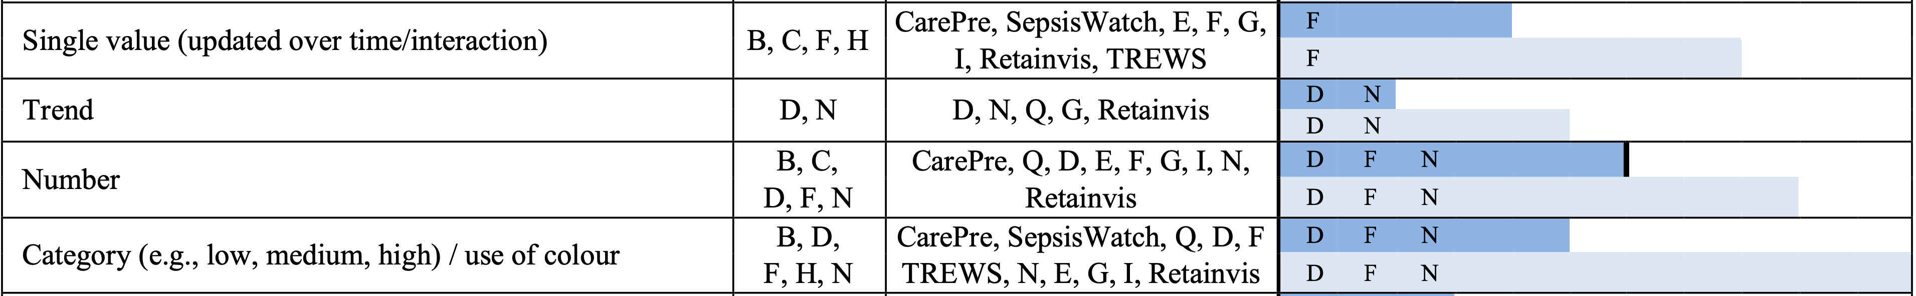
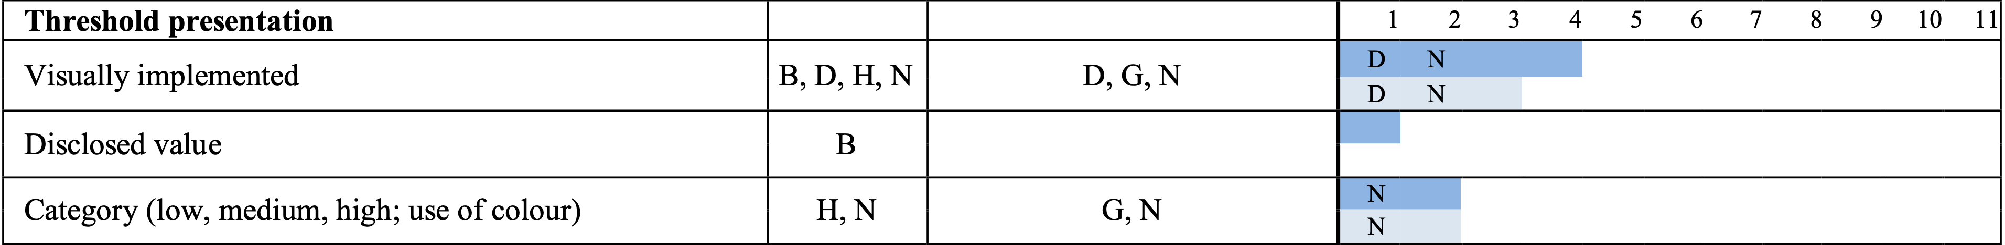
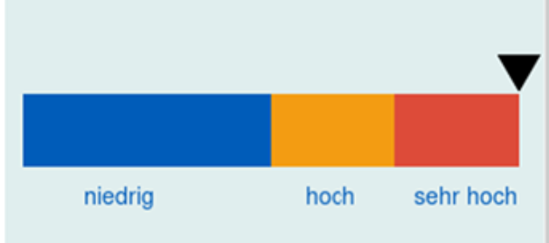


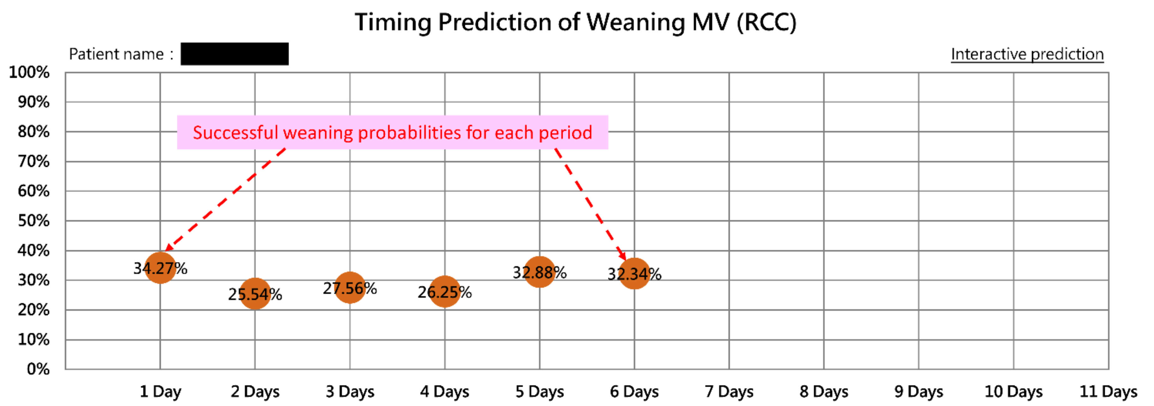
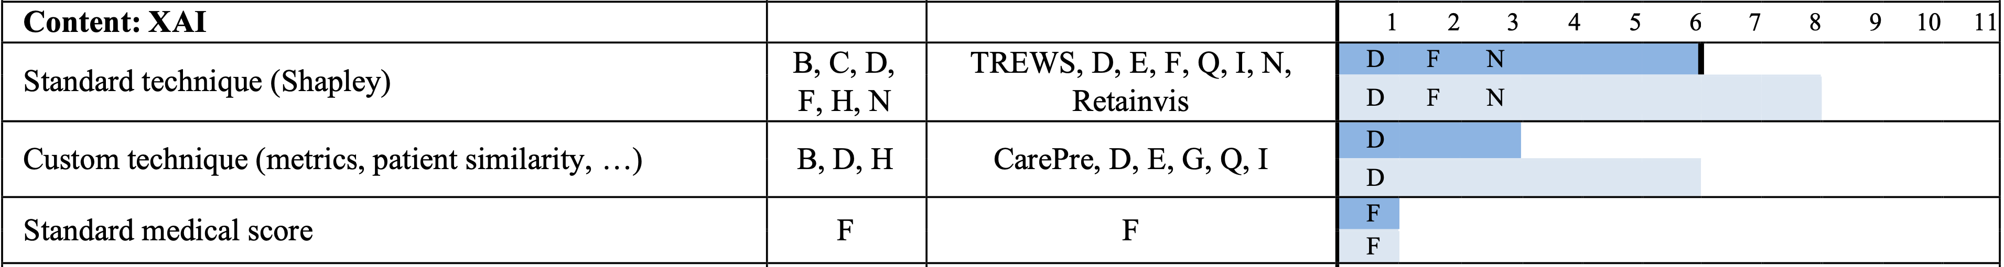
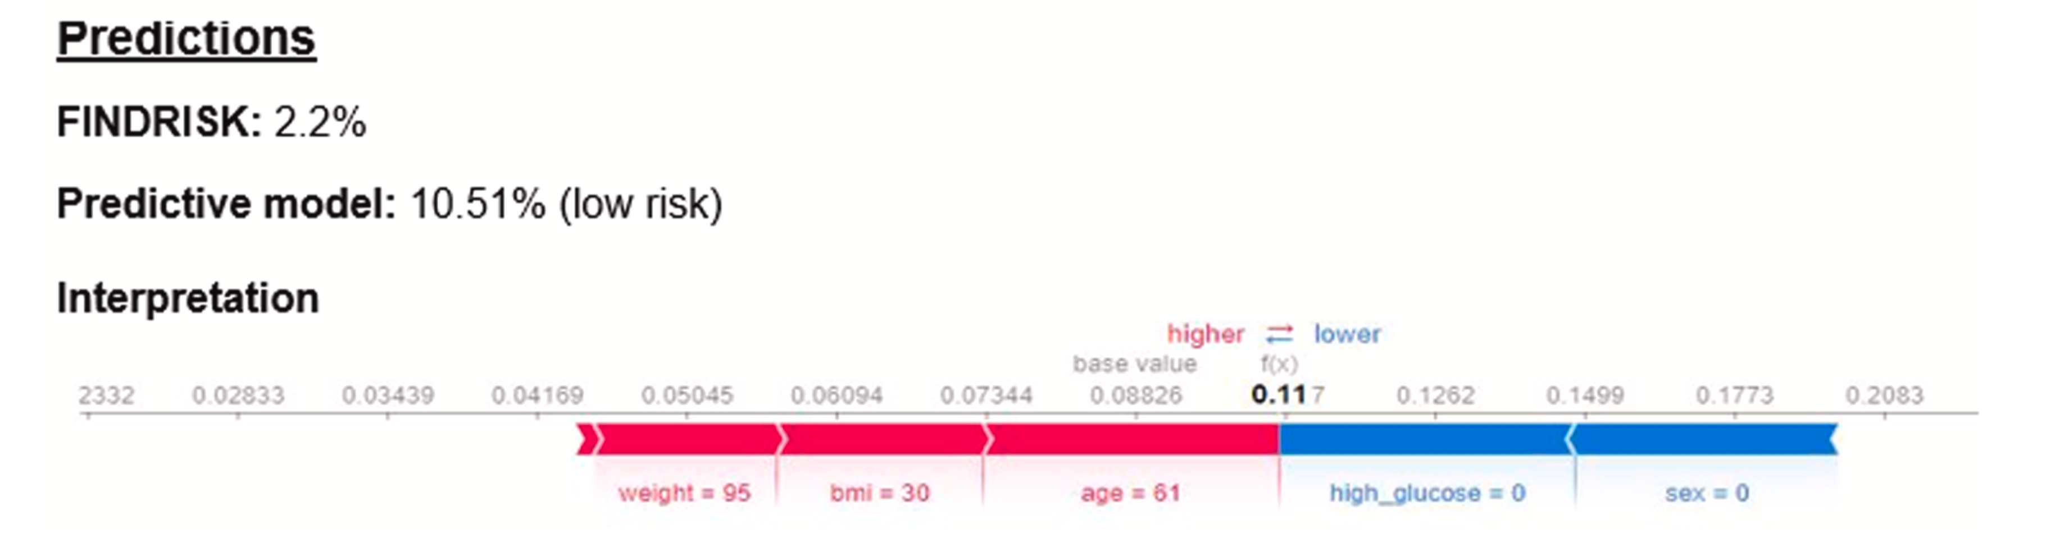
RQ-3 - How are AI predictions presented to clinicians?
QL n=6
Systems that were High Quality User Interface Evaluated (6/21)
2
1
2
3
ENGAGE. DISRUPT. TRANSFORM.
1 - K. M. Liao et al., “Development of an Interactive AI System for the Optimal Timing Prediction of Successful Weaning from Mechanical Ventilation for Patients in Respiratory Care Centers,” Diagnostics, vol. 12, no. 4, Apr. 2022, doi: 10.3390/diagnostics12040975
2 - S. Jauk, D. Kramer, A. Avian, A. Berghold, W. Leodolter, and S. Schulz, “Technology Acceptance of a Machine Learning Algorithm Predicting Delirium in a Clinical Setting: a Mixed-Methods Study”, doi: 10.1007/s10916-021-01727-6/Published..
3 - S. V. Kovalchuk, G. D. Kopanitsa, I. V. Derevitskii, G. A. Matveev, and D. A. Savitskaya, “Three-stage intelligent support of clinical decision making for higher trust, validity, and explainability,” J. Biomed. Inform., vol. 127, Mar. 2022, doi: 10.1016/j.jbi.2022.104013..

Slide 22
RQ-3 - How are AI predictions presented to clinicians?
QL n=6
Systems that were High Quality User Interface Evaluated (6/21)
2
1
3
ENGAGE. DISRUPT. TRANSFORM.
1 - K. M. Liao et al., “Development of an Interactive AI System for the Optimal Timing Prediction of Successful Weaning from Mechanical Ventilation for Patients in Respiratory Care Centers,” Diagnostics, vol. 12, no. 4, Apr. 2022, doi: 10.3390/diagnostics12040975
2 - S. Jauk, D. Kramer, A. Avian, A. Berghold, W. Leodolter, and S. Schulz, “Technology Acceptance of a Machine Learning Algorithm Predicting Delirium in a Clinical Setting: a Mixed-Methods Study”, doi: 10.1007/s10916-021-01727-6/Published..
3 - S. V. Kovalchuk, G. D. Kopanitsa, I. V. Derevitskii, G. A. Matveev, and D. A. Savitskaya, “Three-stage intelligent support of clinical decision making for higher trust, validity, and explainability,” J. Biomed. Inform., vol. 127, Mar. 2022, doi: 10.1016/j.jbi.2022.104013..

Slide 23
RQ-3 - How are AI predictions presented to clinicians?
Threshold is the value that determines when the AI’s continuous prediction (usually a probability between 0 and 1) becomes a positive vs. negative classification
for example, when the model decides that a patient does or does not have sepsis risk.
QL n=6
Systems that were High Quality User Interface Evaluated (6/21)
1
2
3
ENGAGE. DISRUPT. TRANSFORM.
1 - K. M. Liao et al., “Development of an Interactive AI System for the Optimal Timing Prediction of Successful Weaning from Mechanical Ventilation for Patients in Respiratory Care Centers,” Diagnostics, vol. 12, no. 4, Apr. 2022, doi: 10.3390/diagnostics12040975
2 - S. Jauk, D. Kramer, A. Avian, A. Berghold, W. Leodolter, and S. Schulz, “Technology Acceptance of a Machine Learning Algorithm Predicting Delirium in a Clinical Setting: a Mixed-Methods Study”, doi: 10.1007/s10916-021-01727-6/Published..
3 - S. V. Kovalchuk, G. D. Kopanitsa, I. V. Derevitskii, G. A. Matveev, and D. A. Savitskaya, “Three-stage intelligent support of clinical decision making for higher trust, validity, and explainability,” J. Biomed. Inform., vol. 127, Mar. 2022, doi: 10.1016/j.jbi.2022.104013..

Slide 24
RQ-3 - How are AI predictions presented to clinicians?
QL n=6
Systems that were High Quality User Interface Evaluated (6/21)
1
2
3
ENGAGE. DISRUPT. TRANSFORM.
1 - K. M. Liao et al., “Development of an Interactive AI System for the Optimal Timing Prediction of Successful Weaning from Mechanical Ventilation for Patients in Respiratory Care Centers,” Diagnostics, vol. 12, no. 4, Apr. 2022, doi: 10.3390/diagnostics12040975
2 - S. Jauk, D. Kramer, A. Avian, A. Berghold, W. Leodolter, and S. Schulz, “Technology Acceptance of a Machine Learning Algorithm Predicting Delirium in a Clinical Setting: a Mixed-Methods Study”, doi: 10.1007/s10916-021-01727-6/Published..
3 - S. V. Kovalchuk, G. D. Kopanitsa, I. V. Derevitskii, G. A. Matveev, and D. A. Savitskaya, “Three-stage intelligent support of clinical decision making for higher trust, validity, and explainability,” J. Biomed. Inform., vol. 127, Mar. 2022, doi: 10.1016/j.jbi.2022.104013..

Slide 25

RQ-3 - How are AI predictions presented to clinicians?
What level of explainable information (xAI) should we present?
patient-specific details / threshold patient similarity feature-based information metrics of model confidence model performance evidence from validation studies
To complement or challenge clinician’s reasoning
QL n=6
Systems that were High Quality User Interface Evaluated (6/21)
1
2
3
ENGAGE. DISRUPT. TRANSFORM.
1 - K. M. Liao et al., “Development of an Interactive AI System for the Optimal Timing Prediction of Successful Weaning from Mechanical Ventilation for Patients in Respiratory Care Centers,” Diagnostics, vol. 12, no. 4, Apr. 2022, doi: 10.3390/diagnostics12040975
2 - S. Jauk, D. Kramer, A. Avian, A. Berghold, W. Leodolter, and S. Schulz, “Technology Acceptance of a Machine Learning Algorithm Predicting Delirium in a Clinical Setting: a Mixed-Methods Study”, doi: 10.1007/s10916-021-01727-6/Published..
3 - S. V. Kovalchuk, G. D. Kopanitsa, I. V. Derevitskii, G. A. Matveev, and D. A. Savitskaya, “Three-stage intelligent support of clinical decision making for higher trust, validity, and explainability,” J. Biomed. Inform., vol. 127, Mar. 2022, doi: 10.1016/j.jbi.2022.104013..

Slide 26
So what?
Personalisation and Drill-down information:
Allow UI tailoring to clinician needs: moving from a general overview to progressively more detailed and specific levels as they need more information.
ENGAGE. DISRUPT. TRANSFORM.

Slide 27

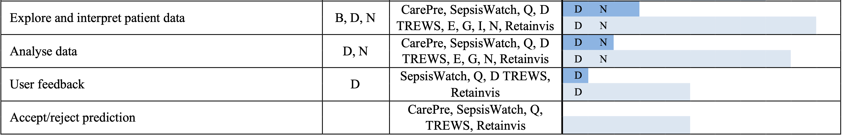
RQ-4 - When are interactive, rather than static, visualisations used and what is their purpose and value?
QL n=6
Systems that were High Quality User Interface Evaluated (6/21)
ENGAGE. DISRUPT. TRANSFORM.

Slide 28
RQ-4 - When are interactive, rather than static, visualisations used and what is their purpose and value?
Critical thinking
ENGAGE. DISRUPT. TRANSFORM.

Slide 29
RQ-4 - When are interactive, rather than static, visualisations used and what is their purpose and value?
Critical thinking
Supporting System
ENGAGE. DISRUPT. TRANSFORM.

Slide 30
RQ-4 - When are interactive, rather than static, visualisations used and what is their purpose and value?
Critical thinking
Supporting System
Trust
ENGAGE. DISRUPT. TRANSFORM.

Slide 31
RQ-4 - When are interactive, rather than static, visualisations used and what is their purpose and value?
Time Constraint
Critical thinking
Supporting System
Trust
ENGAGE. DISRUPT. TRANSFORM.

Slide 32
RQ-4 - When are interactive, rather than static, visualisations used and what is their purpose and value?
Time Constraint
Critical thinking
Cognitive Overload
Supporting System
Trust
ENGAGE. DISRUPT. TRANSFORM.

Slide 33
RQ-4 - When are interactive, rather than static, visualisations used and what is their purpose and value?
Time Constraint
Critical thinking
Cognitive Overload
Supporting System
Trust
Deskilling
ENGAGE. DISRUPT. TRANSFORM.

Slide 34
So what?
Interactivity Trade-offs:
While often added through codesign, the benefits vs. time-cost of interactive UIs remain unclear.
ENGAGE. DISRUPT. TRANSFORM.

Slide 35
So what?
Implication for Designers/Developers
Implication for Researchers
Implication for Healthcare Organisations
Use evidence-based design: Build on UI findings to guide component selection and establish a starting point for the design.
Decide integration early: Clarify whether the system will be inside the EMR (minimal addition or advanced app) or external (e.g., dashboard), as this affects cost, usability, and data access.
Leverage codesign wisely: Codesign helps align the system with clinical workflow and user comprehension but may also introduce subjective preferences without objective validation.
Support customisation and communication: Allow UI tailoring to clinician needs: the UI is the critical to link algorithm performance and clinical impact.
Incorporate feedback loops: Clinician feedback during and after design promotes usability, engagement, and continuous improvement.
No UI Evaluation Standards: Unlike algorithm accuracy (TRIPOD-AI) or intervention impact (CONSORT-AI), there are no equivalent standards for AI-CDSS UI evaluation.
Limitations of XAI: Heavy reliance on Shapley techniques: need to test and refine new approaches like evaluative AI.
Single-Task Systems Risk: Most AI-CDSS are dedicated to single tasks, raising concerns about neglecting differential diagnoses and workflow fragmentation.
Interactivity Trade-offs: While often added through codesign, the benefits vs. time-cost of interactive UIs remain unclear.
Unclear Codesign Effectiveness: It is unknown which codesign methods work best for improving clinician satisfaction, efficiency, and overall system success.
Rigorous Evaluation: Ensure thorough UI evaluations with clinicians are conducted and transparently reported before implementation.
Ongoing Feedback: Establish continuous evaluation protocols that integrate clinician feedback to refine AI-CDSS over time.
Clinician Involvement: Promote active clinician participation in design and implementation to create more effective tools.
Training & Safety: Provide staff training on interpreting outputs and XAI to prevent automation bias and over-reliance on AI.
Standardisation: Encourage more standardised UI designs (with local customisation) to support clinician usability across diverse systems.
ENGAGE. DISRUPT. TRANSFORM.

Slide 36
[champion’s citation]
“I think people underestimate how complicated this (UI) is.
The complexity is in the machine learning and the algorithm. But that's almost the tip of the iceberg.
The rest of it is really complicated.
How do you get people to change their behaviour?”
BRISBANE | 24-25 NOVEMBER 2025
Thank you

